Slide 1
Una Quinn
Trinity College Dublin

Slide 2
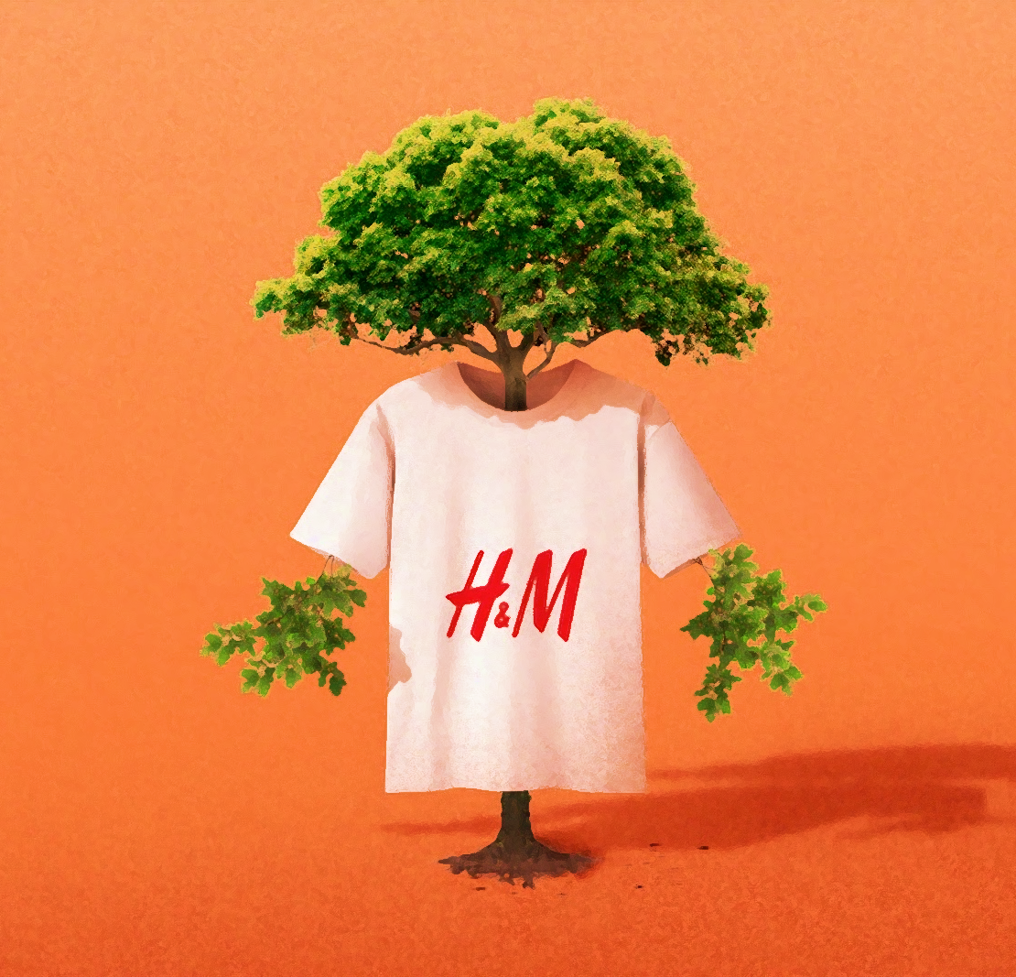
Za kakšno ceno?
Premislek o industriji hitre mode
Notes:
2

Slide 3
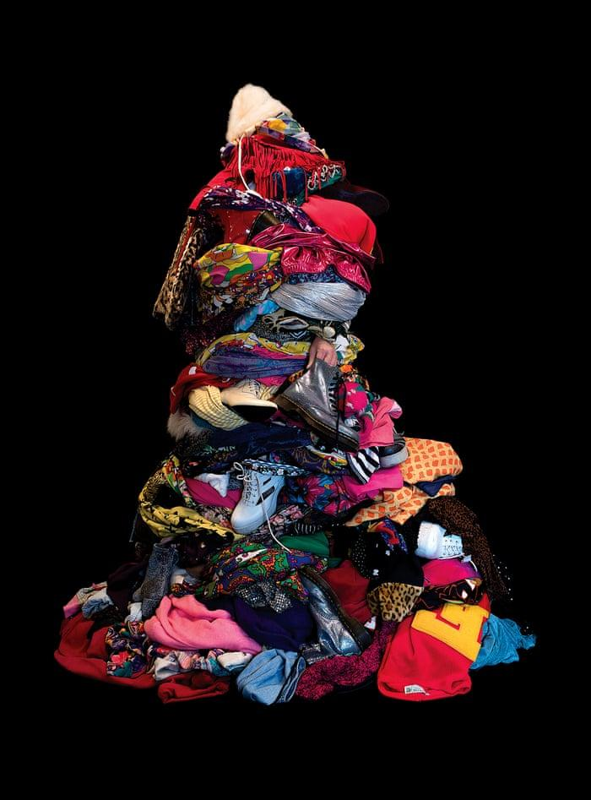
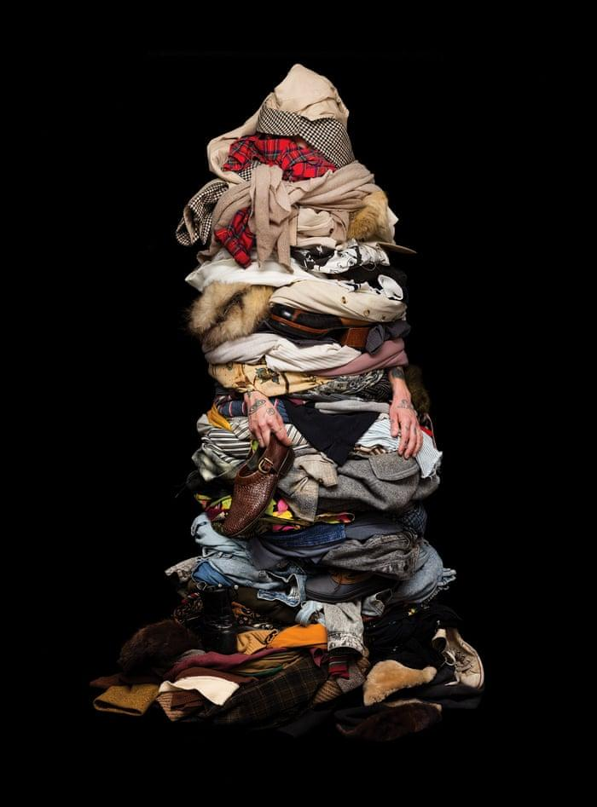
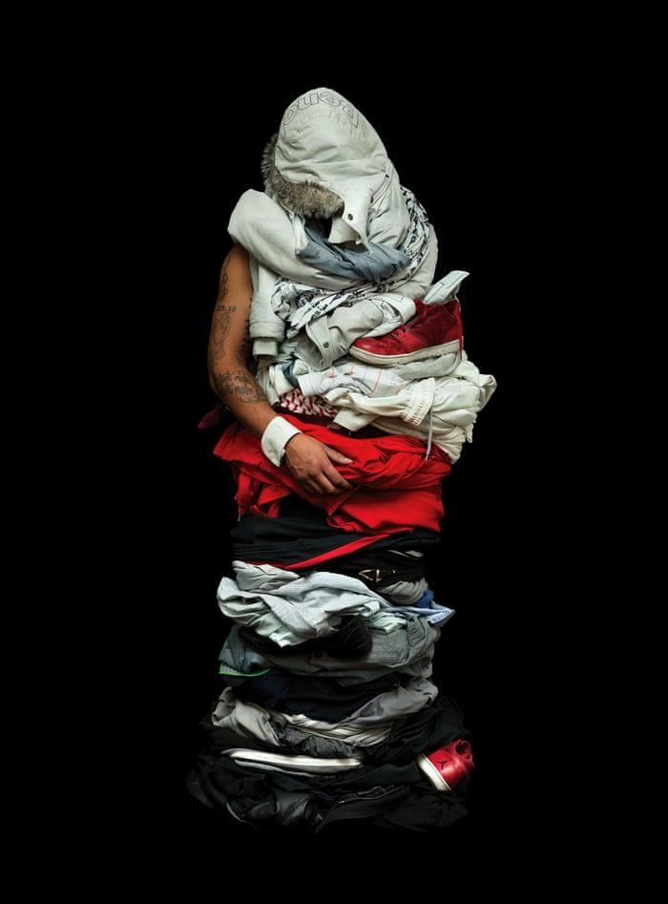
‘Soft shells’, Libby Oliver, 2017.
Kaj je hitra moda?
Notes:
Learning outcome:
To explore the students current understanding of fast-fashion
Suggested:
What do these images say to you?
What does fast-fashion mean to you?
Do you think it applies to boys as much as girls?
Is it something you have thought about before/ are aware of?
Images:
Libby Oliver’s series ‘Soft shells’ where participants were photographed wearing all of the clothing they owned, https://chewonthisart.com/Soft-Shells, 2017-ongoing.

Slide 4
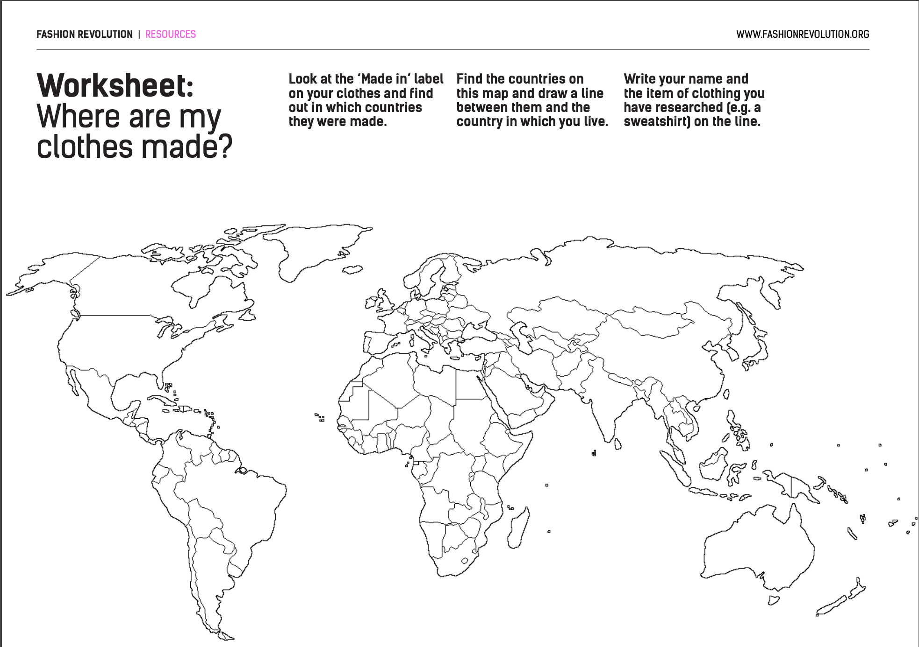
Kje so proizvedena moja oblačila?
Notes:
ACTIVITY ONE: Where Are My Clothes Made? (PP #3)
Overview: To read the information available on an item of clothing and understand the origin of it (eg the growing of the fabric, resources used, people involved, the transport)
*Alternative: Flipped classroom (student assigned task of preselecting an item at home, may include research of chosen brand etc. for discussion).
Learning Outcome: To encourage the ‘Collection, analysis and presentation of data’.
Materials Needed/Classroom Setup :
Item of Clothing/ Accessory/ Device
World Map (PP #3)
Suggested Time: 15-20mins
Suggested Activity Introduction for Students : Ask students to select their item of clothing (either brought in from home/ on them/ technology device or schoolbag also works. Analyse the information included on the label. Encourage them to discuss in small groups what information they have found.
Reflection Prompts
As a group, or individually, ask students to find these countries on a world map and highlight them (Use PP#3 if needed)
Ask students to work out which countries are most popular for making their clothes
Ask students to draw lines on their maps between the country in which they live and those where their items of clothing were made
Discuss findings.
Source: fashionrevolution.org

Slide 5
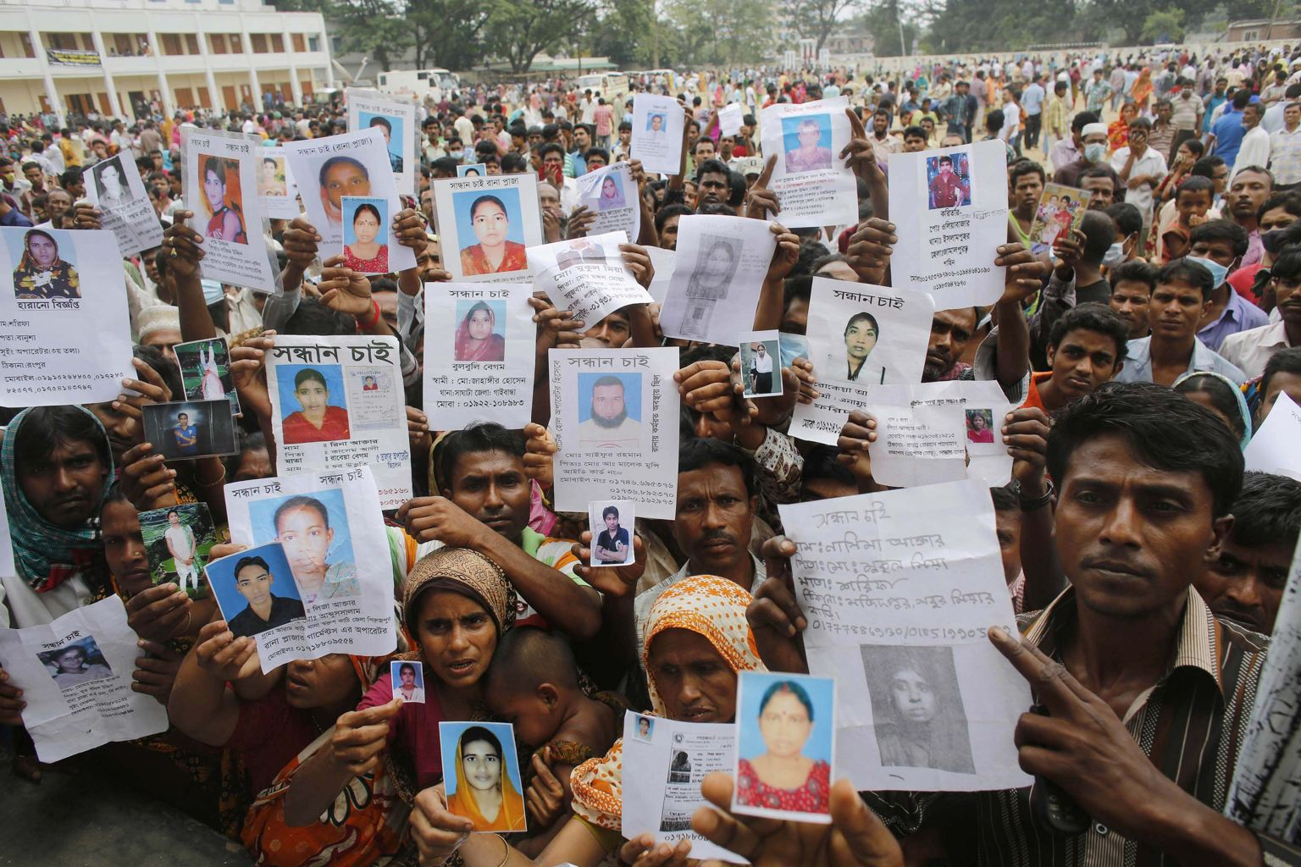
Kje so proizvedena moja oblačila?
Leta 2013 se je, kljub opozorilom, da stavba ni varna, v Bangladešu zrušila stavba Rana Plaza in pri tem pod seboj pokopala 1134 delavcev.
Ali si želiš, da bi bila blagovna znamka transparentna glede pogojev na delovnem mestu, v katerem je nastalo tvoje novo oblačilo?
Bi to vplivalo na tvojo odločitev pri nakupu predmeta?
#GOTRANSPARENT
Notes:
Learning Outcome:
Link to ‘reluctance to report unethical behaviour’ and its consequences
Are there examples in other areas? Aim to include school and knowledge of cheating
Understand the need for transparency in the context of fast-fashion
To understand the risks and conditions of work facilitated to create our clothing:
Pay far below minimum wage
Poor and unsafe work conditions
Exposure to toxic chemicals and waste to all living in surrounding area.
Add:
A report released in June 2020 by “Labour Behind the Label” showed that textile workers in Leicester, UK were working for £3.50/hr and work did not stop during the COVID-19 pandemic.

Slide 6
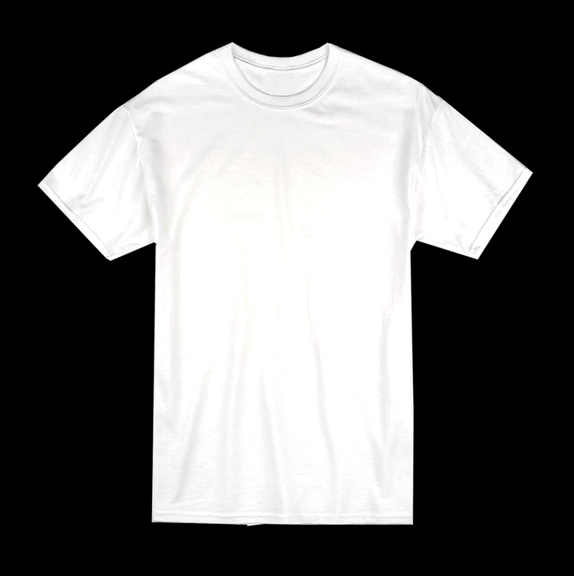
4 stebri hitre mode
1. Pogoji
2. Sestava
3. Kultura
4. Poraba
Notes:
Conditions
Worker exploitation of creating one garment like a tshirt
Composition
Environmental impact of materials used like cotton (high water intensity) and synthetic fabrics (non-biodegradable)
Consumption
Culture
Our buying habits as consumers, and how this has an impact on the fashion industry

Slide 7
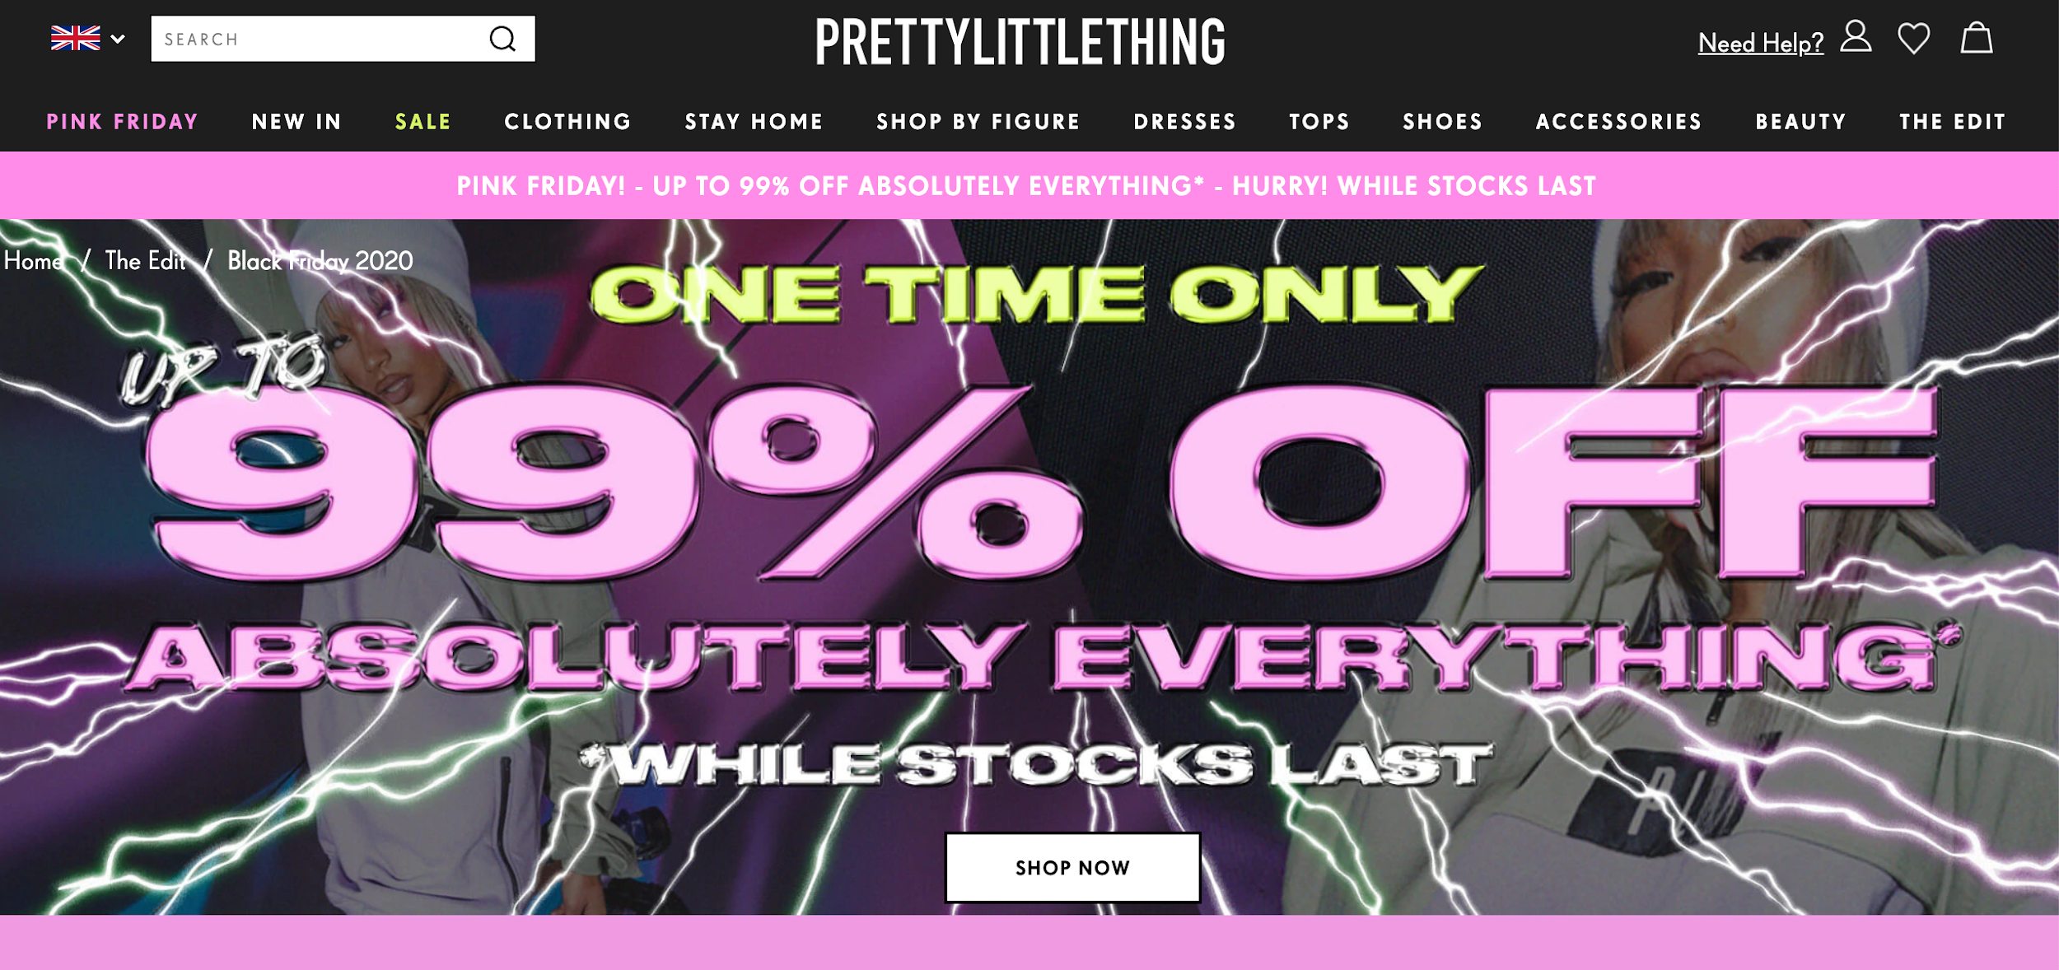
1. Pogoji
Prodaja znamke “Pretty Little Thing” na črni petek leta 2020.
Prodaja je omogočila 99% popust na vsak kos oblačila.
To je pomenilo, da ste lahko kupili vsak izdelek za 0,01 centa.
Notes:
- An image showing a Black Friday sale in 2020, by the brand Pretty Little Thing. The sale offered 99% off every item of clothing. This meant there were items available to buy for 0.01cent.

Slide 8
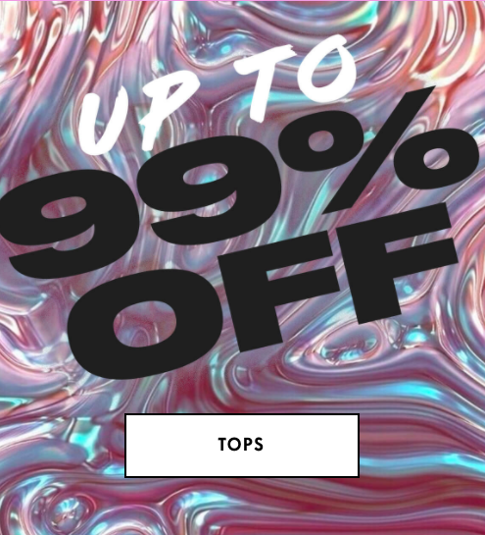
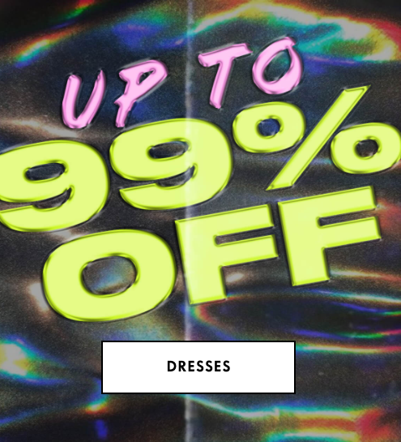
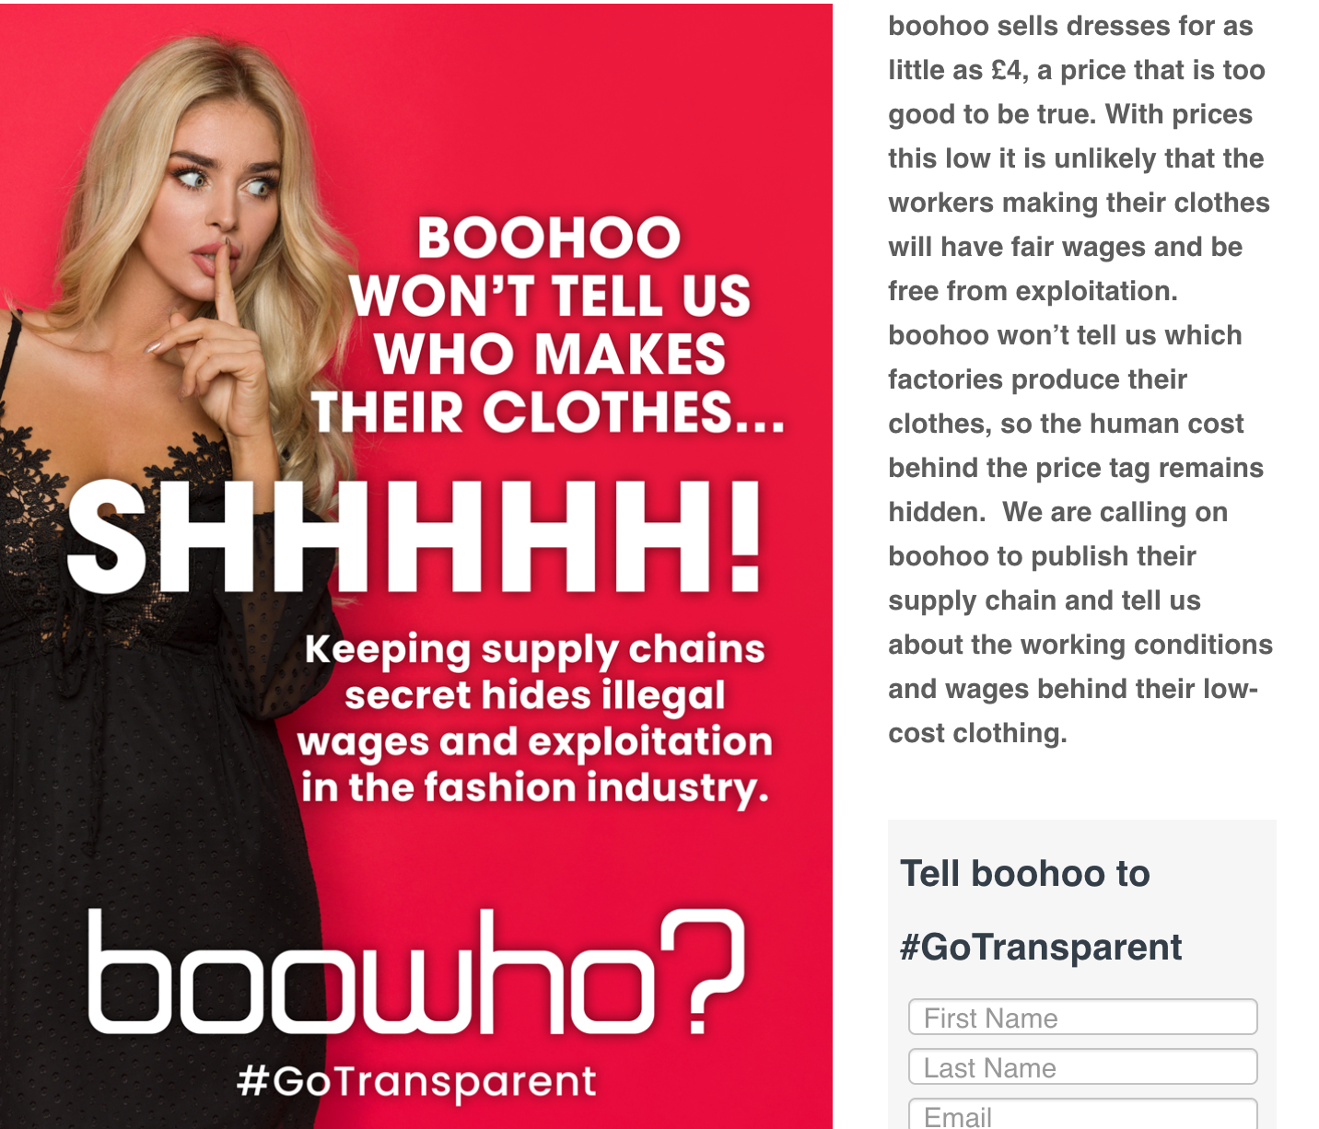
1. Pogoji
Danes lahko oblačila znamk Pretty Little Thing, Boohoo, Sports Direct in drugih blagovnih znamk kupite že za 10 €.
Toda poročilo, ki ga je junija 2020 objavila organizacija "Labour Behind the Label", je pokazalo, da so tekstilni delavci v Leicesterju v Združenem kraljestvu delali za 3,50 GBP/uro. Delo se med pandemijo COVID-19 ni ustavilo.
Še nekaj primerov:
source: https://labourbehindthelabel.org/boohoo/
Notes:
Source: https://labourbehindthelabel.org/boohoo/

Slide 9
1. Pogoji
"JD Sports, Amazon UK, TK Maxx in Missguided so med številnimi britanskimi modnimi trgovci, ki so bili javno osramočeni, ker niso sprejeli ukrepov za spodbujanje okoljske trajnosti ter zaščite svojih delavcev.”
Bi raje kupovali pri trgovcih z boljšimi standardi varovanja okolja in odnosa do zaposlenih?
Source: ITV News article, 2019

Slide 10
2. Sestava
Koliko litrov vode je potrebno za izdelavo ene bombažne majice?
Notes:
Learning Objective:
To emphasise that even something as basic as a tshirt, can take a huge amount of resources to create.

Slide 11
2. Sestava
Do 2,700 litrov
To je več kot dve leti pitne vode za eno osebo.
Medtem ko za izdelavo tekstila na plastični osnovi vsako leto potrebujemo približno 342 milijonov sodov nafte.
Sintetični tekstil ni razgradljiv.
Ne pozabite na kemične odpadke, pesticide, poceni delovno silo in porabo goriva.
Source: Ellen MacArthur Foundation, 2017.
Notes:
Discussion Qs:
- What fabrics are biodegradable?
- What fabrics are not?
- How often do you check the label on your clothing to see what it is made of and where?
- Do you think it is important to do so?

Slide 12
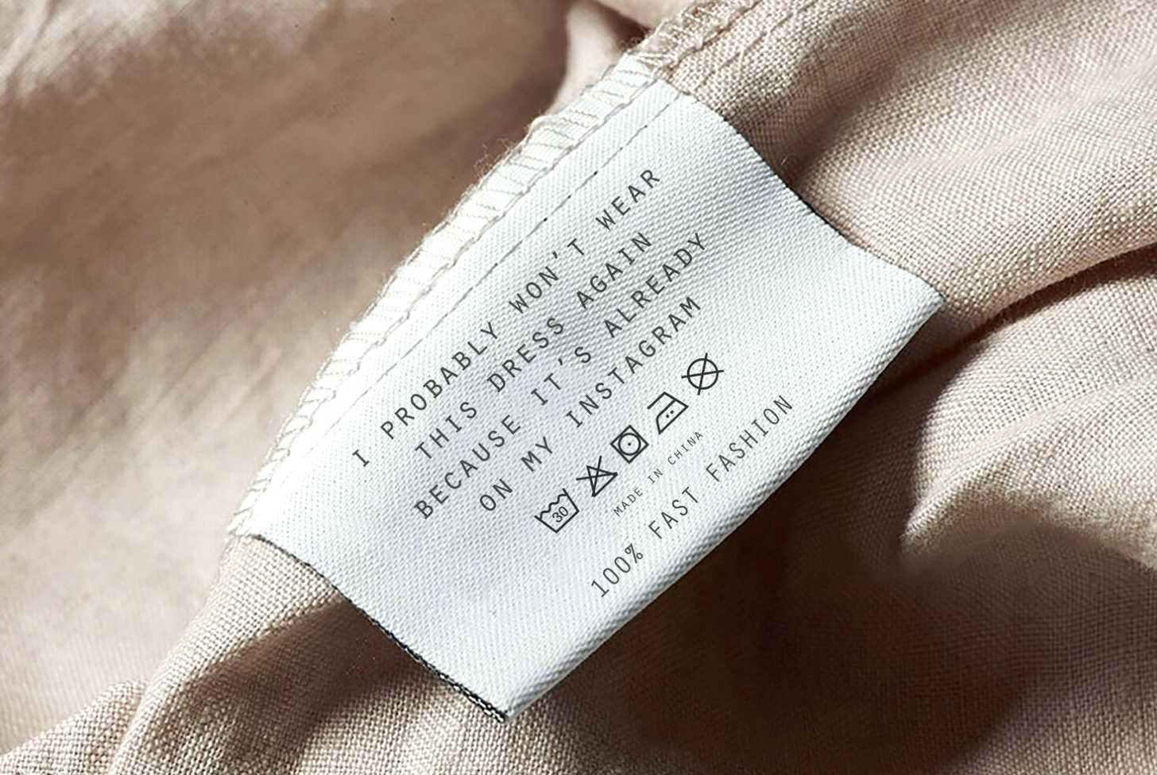
3. Kultura: Zapiši svojo deklaracijo
Elizabeth Illing, @project_stopshop, je to sliko ustvarila na podlagi izjav, ki jih je prejela med intervjuji.
Ali se lahko poistovetite?
https://www.globalgarbs.com/blog/project-stopshop-sustainable-fashion

Slide 13
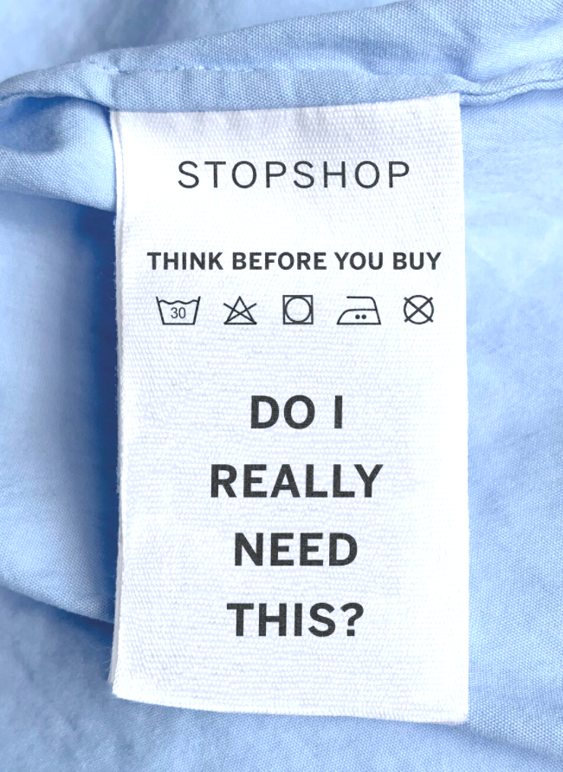
Kakšna je tvoja osebna deklaracija?
Pretiravajte s pozitivnim prispevkom o etični in trajnostni modi. Uporabljajte manipulativno in zavajajočo terminologijo in podobe.
Odvračajte pozornost od množične proizvodnje oblačil hitre mode.
Pred nakupom premisli:
Ali to dejansko potrebujem?
Notes:
https://www.globalgarbs.com/blog/project-stopshop-sustainable-fashion
Activity Part One: Ask students to create their own transparent or honest label (a short slogan reflecting their own buying habits or realities of fast-fashion)

Slide 14
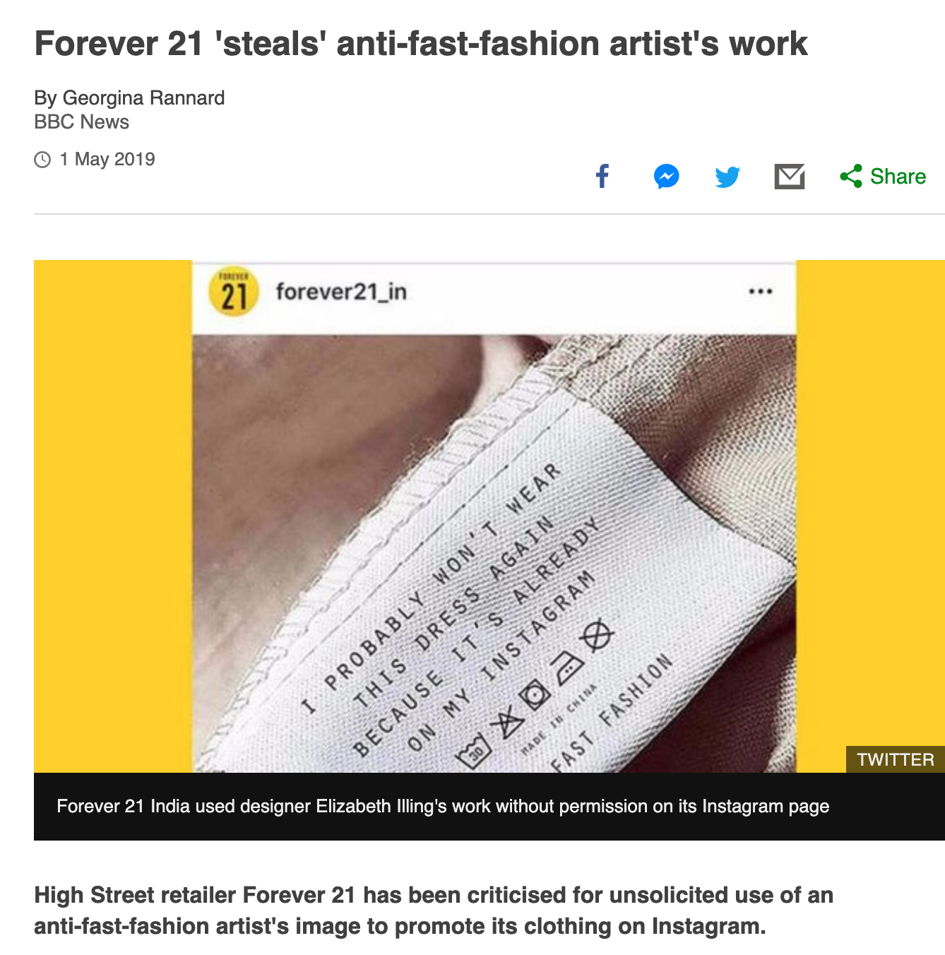
Deklaracija: ukradeno avtorstvo
In prav tako ekspresno je znamka hitre mode “Forever21” brez dovoljenja kopirala Illingovo delo, da bi promovirala točno tisto, proti čemur se Illingova bori.
Se vam zdi to pošteno?
To kaže, kako je mogoče napačno predstaviti idejo, ko podjetje brez dovoljenja ali potrdila kopira delo nekoga drugega.
Si lahko omislite druge primere ali načine, kako se to lahko zgodi?
https://www.bbc.com/news/blogs-trending-48122040
Notes:
Learning Objective:
To understand that stolen work can happen in any industry, and happens very often in the fashion in dustry
To link this back to the core integrity issue of plagiarism and authorship.
To discuss how prevalent it is for original work to be copied and reposted without acknowledging the author, especially with social media.

Slide 15
Zara si prisvoji avtorsko delo umetnice Tuesday Bassen
Se strinjate z odgovorom predstavnikov Zare?
Koliko se mora avtorsko delo spremeniti iz prvotnega, da se ne šteje za ukradeno delo?
Tudi če se nekaj zelo razlikuje od prvotnega dela, ali bi morali avtorja vedno potrditi?
Notes:
To explore…
Social media influencers (Brand ambassadors) and the new wave of ethical greenwashing
What responsibility does someone with a social media following have when promoting a product?
If you knew that the influencer was only promoting the item because they were paid, would that impact your decision?
What other impacts can a social media influencer have on an individual?
Similarly, brands often promote sustainability and diversity in a bid to appear more ethical, but how often is it true once you look behind the scenes and behind the images.
Activity: Facilitate a debate over the pros and cons of social media influencers, inspired by the questions above.

Slide 16
Zara si prisvoji avtorsko delo umetnice Tuesday Bassen
Se strinjate z odgovorom predstavnikov Zare?
Koliko se mora avtorsko delo spremeniti iz prvotnega, da se ne šteje za ukradeno delo?
Tudi če se nekaj zelo razlikuje od prvotnega dela, ali bi morali avtorja vedno potrditi?
Glede tega sem bila do sedaj tiho. V zadnjem letu je @zara kopirala moja umetniška dela (hvala vsem, ki ste me na to opozorili – veliko vas je bilo). Moja odvetnica je stopila v stik s predstavniki Zare, ki so mi dobesedno odgovorili, da za pritožbo nimam osnove, ker sem alternativna umetnica, ki jo ne pozna veliko ljudi, oni pa so velika korporacija. Načrtujem nadaljne pritožbe, toda že samo plačali odvetnice sem doslej plačala $2k. Grozno in žalostno obenem, da moram zapraviti ves svoj denar, samo da branim, kar je zakonito moje. EDIT: Nekateri me sprašujete, kako lahko pomagate. Zgodbo lahko objavite in jih označite na Twitterju, Instagramu, Facebooku.
Zavračamo vaše trditve zaradi že zgoraj navedenih razlogov; pomanjkanje domnevnih značilnosti oblikovalskih izdelkov vase stranke napeljuje na vprašanje, kako bi večina svetovnega prebivalstva povezovala naše izdelke z Tuesday Bassen. To je naše trdno stališče v zavedanju obvestil 3.stranke, s katerimi ste nas seznanili. Z zvezi s tem, upoštevajte, da tovrstna obvestila pomenijo zgolj majhno število pritožb, če upoštevamo, da milijoni uporabnikov po vsem svetu mesečno obiskujejo spletna mesta Zare (98.000.00 povprečnih mesečnih obiskov lani) in Bershka (15.000.000 povprečnih mesečnih obiskov lani). Te številke postavijo tistih nekaj obvestil v jasno persektivo.
Notes:
To explore…
Social media influencers (Brand ambassadors) and the new wave of ethical greenwashing
What responsibility does someone with a social media following have when promoting a product?
If you knew that the influencer was only promoting the item because they were paid, would that impact your decision?
What other impacts can a social media influencer have on an individual?
Similarly, brands often promote sustainability and diversity in a bid to appear more ethical, but how often is it true once you look behind the scenes and behind the images.
Activity: Facilitate a debate over the pros and cons of social media influencers, inspired by the questions above.

Slide 17
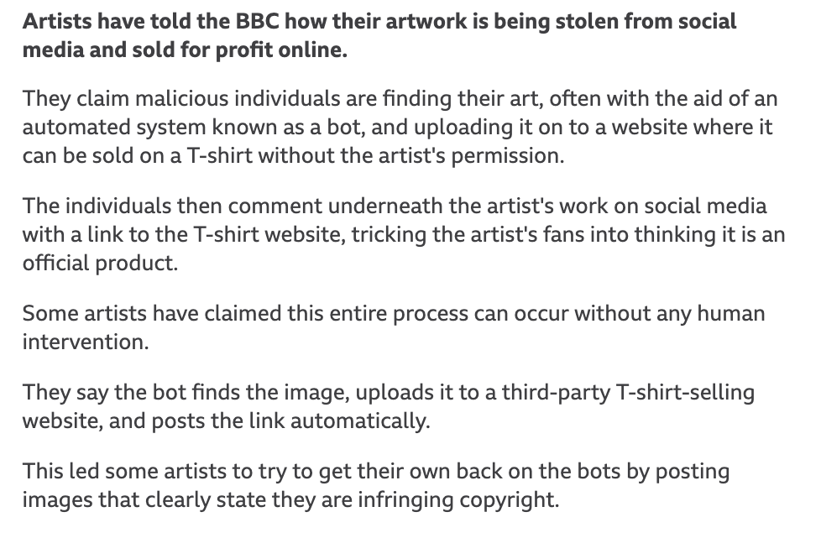
Imamo celo avtomatizirane bote, ki jih obtožujejo kraje avtorskih del ...
Source: BBC News, Dec 2019.

Slide 18
Imamo celo avtomatizirane bote, ki jih obtožujejo kraje avtorskih del ...
Kako roboti kradejo avtorska dela umetnikom na Twitterju
Umetniki so za BBC dejali, kako se njihova umetniška dela kradejo iz socialnih omrežjih in na spletu naprej prodajajo za dobiček.
Trdijo, da zlonamerni posamezniki najdejo njihova umetniška dela, pogosto s pomočjo avtomatiziranega sistema, znanega kot “robot”, jih naložijo na drugo spletno mesto, kjer ga je mogoče prodati kot odtis na kratki majici brez privolitve avtorja.
Posamezniki nato v komentarjih umetnikove spletne strani ponujajo blago, kot da gre za uradni izdelek.
Nekateri umetniki pravijo, da se celoten postopek lahko zgodi brez kakršnega koli posega človeka.
Pravijo, da robot sliko najde, jo naloži na spletno mesto trgovine za prodajo majic in samodejno objavi povezavo.
Nekaj umetnikov se je domislilo, kako prelisičiti robote, objavili so slike, na katerih je jasno navedeno, da se kršijo avtorske pravice.
Source: BBC News, Dec 2019.

Slide 19
4. Poraba
Evropejci vsako leto zavržemo 2 milijona ton tekstila. Vsako sekundo se tovornjak tesktila zažge ali odvrže na odlagališča.
Po vsem svetu je 70% podarjenih oblačil izvoženih v podsaharsko Afriko.
Približno polovica teh konča na lokalnih odlagališčih in kontaminira vodne sisteme s strupenim in nerazgradljivim tekstilom.
https://www.textilemountainfilm.com/
Notes:
Learning Objective:
Responsibility for the products we consume and understanding that the item does not cease to exist when we dispose of it.
To challenge our throw-away culture, and the resources used to dispose of these items
Textile Mountain Resources: Also, image in different languages.
https://www.textilemountainfilm.com/resources
Sources from film:
‘150 billion items of clothing are produced annually’- Sustainable Apparel Materialshttps://matteroftrust.org/wp-content/uploads/2015/10/SustainableApparelMaterials.pdf
‘In Europe, we throw away 2 million tonnes of textiles each year.’ Fashion Waste Index by Labfreshhttps://labfresh.eu/pages/fashion-waste-index?lang=en&locale=en
‘70% of our discarded clothes end up in Africa.’ Oxfam, as quoted in The Guardian ‘How second hand clothes are creating a dilemma for Kenya’https://www.theguardian.com/world/2015/jul/06/second-hand-clothing-donations-Kenya
‘Kenya imports over 140,000 tonnes of second hand clothes each year’ USAID2017: Overview of The Used Clothing Market in East Africa: Analysis of Determinants & Implications)https://agoa.info/downloads/15244.html
‘An estimated 20million kg of textiles are landfilled each year in Kenya alone’.(Africa Collect Textiles)
‘Our clothing consumption has more than doubled in the last 15 years, yet each garment is now kept half as long’.McKinsey 2016https://www.mckinsey.com/business-functions/sustainability/our-insights/style-thats-sustainable-a-new-fast-fashion-formula
‘Textiles make up to 12% of all landfill waste’.https://www.makegood.world/fashions-problem-with-waste

Slide 20
Recikliramo. Sodelujemo pri ustvarjanju.
Patagonia
Mobilna aplikacija, pametni oglas ali celo lokalna trgovina ponovne uporabe, ustvarjalnost pri ponovni uporabi oblačil lahko pomaga zmanjšati količino odpadkov in se lahko celo spremeni v donosen poslovni model.
Tu je še nekaj primerov ...
Notes:
This advertisement was released on Black Friday in 2011 by Patagonia about its own product, in a bid to discourage consumers from impulse buying.
Learning Objective: - Encourage students to be creative about how to reinvent the items they would dispose of, and encourage collaboration

Slide 21
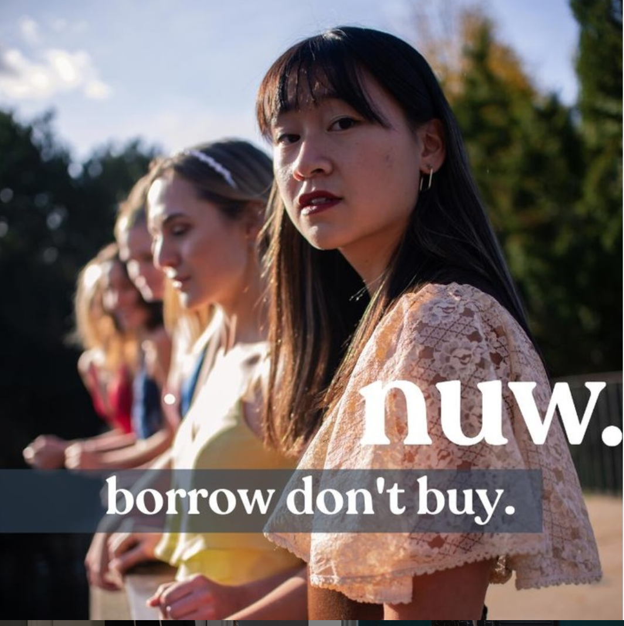
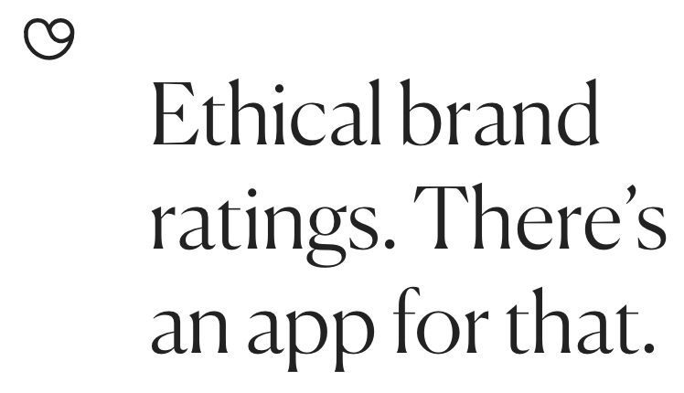
Sodelujte pri ustvarjanju
@wearenuw, irska mobilna aplikacija, kjer si lahko oblačila sposodite od drugih
@goodonyou_app je imenik blagovnih znamk, ki na podlagi raziskav in analize podatkov ocenjuje njihove etične standarde
@maisoncleo razdela stroške izdelave enega oblačila za popolno preglednost
Notes:
Examples of creative startups working against fast-fashion:
Maison Cléo: Displays full breakdown of costs to achieve transparency of product. Source: https://www.instagram.com/p/CCBaOK5Ae-W/?utm_source=ig_embed
2) Nu Wardrobe available on your phone, creates a community for consumers to collaborate by uploading their clothes and borrowing from others
3) Good On You: goodonyou.eco gives you the opportunity to check how ethical your favourite brand is, and sets a good example on what to consider when buying your next product.

Slide 22
Čas za refleksijo
Ustvarite kos oblačila, oglas ali aplikacijo, ki bi lahko ponudila alternativo industriji hitre mode
Ga je mogoče uporabiti kot več kot le kos oblačila? Je biološko razgradljiv?
Ali je sestavljen iz stranskih produktov, kot so morske alge, gobe ali ostanki hrane?
Ali druge spodbuja k sodelovanju in ustvarjanju pravičnega delovnega okolja?
Notes:
30mins

Slide 23
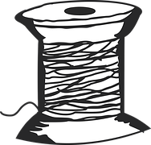
Zaključek
Katera vprašanja so po vašem mnenju ključna v industriji hitre mode?
Ali se ta vprašanja pojavljajo na področjih zunaj poslovanja in mode?
Fashionrevolution.org
Project Stopshop
Global Garbs
Labour Behind the Label
War on Want
Goodonyou.eco

